Slide 1









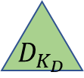




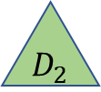




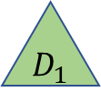
$$P_{1}$$
$$P_{2}$$
$$P_{N}$$
$${ V}_{1}$$
$${ V}_{2}$$
$${ V}_{m_{1}}$$
$${ V}_{1}$$
$${ V}_{2}$$
$${ V}_{m_{2}}$$
$${ V}_{1}$$
$${ V}_{2}$$
$${ V}_{m_{N}}$$
$${ D}_{1}$$
$${ D}_{2}$$
$${ D}_{K_{D}}$$
Patient
Visit
$${ T}_{1}$$
$${ T}_{2}$$
$${ T}_{3}$$
$${ T}_{4}$$
$${ T}_{K_{T}}$$
Diagnosis
Treatment

